Slide 1

Banning Nuclear Weapon Usage

Slide 2
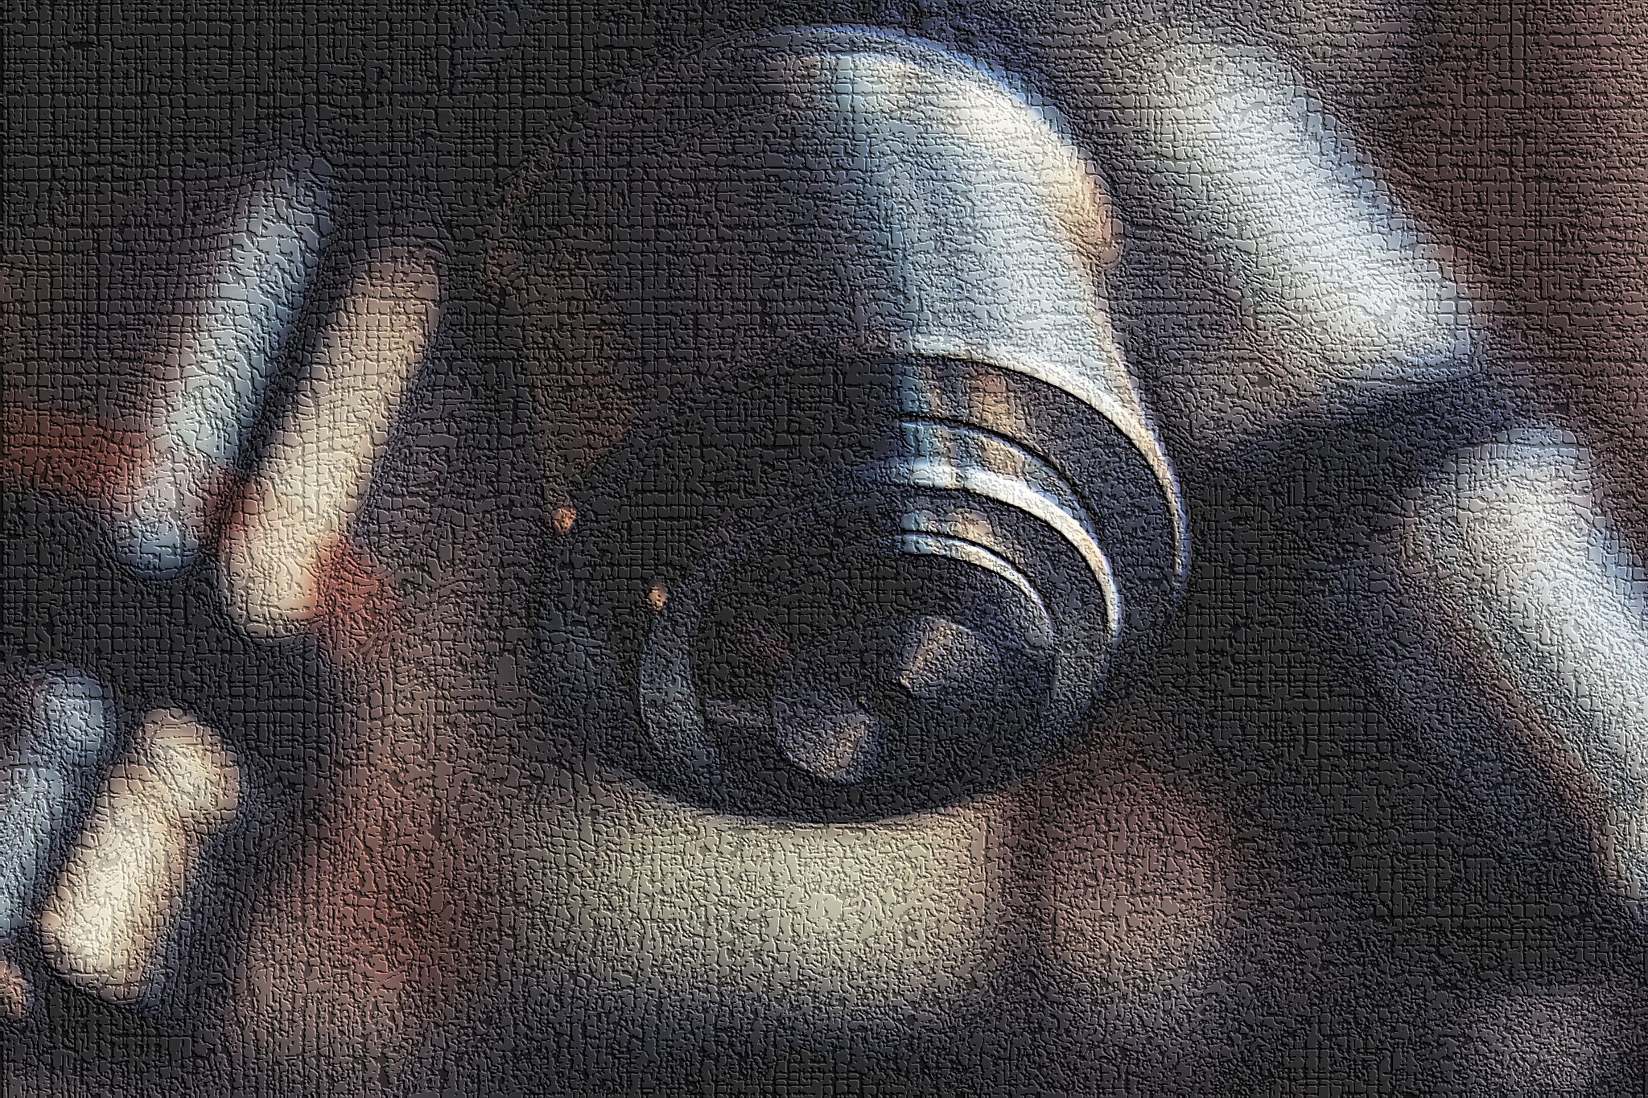
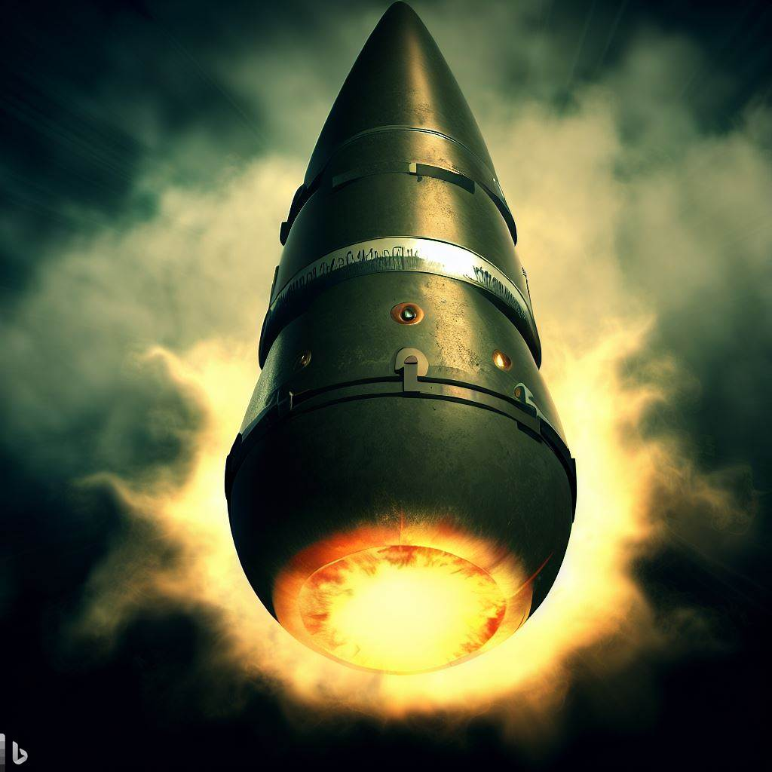
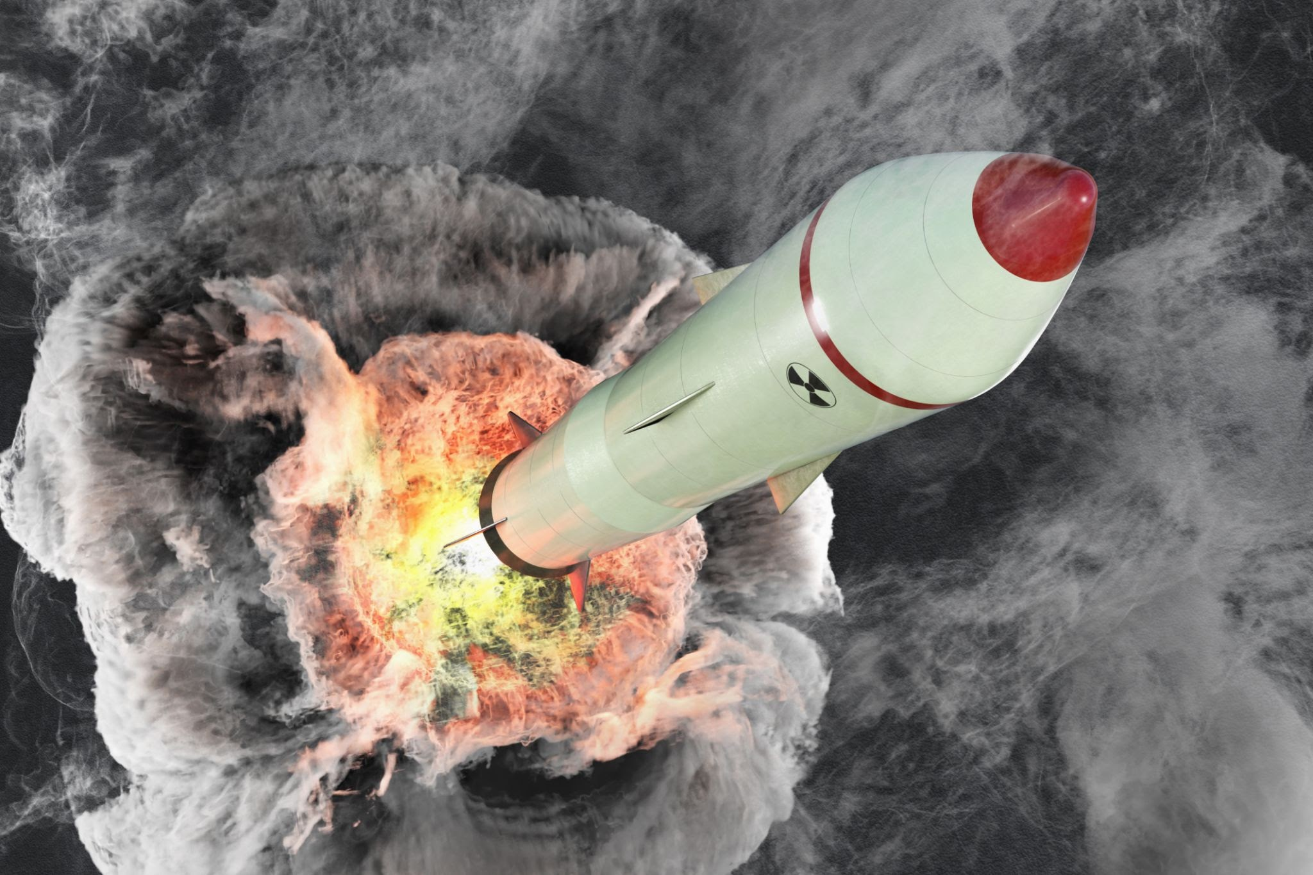
Introduction
What are Nuclear
Weapons ?
How they work ?

Slide 3
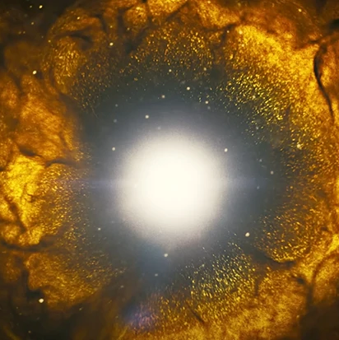
Historical Context of Nuclear Weapons
Discovery of Radioactivity

Slide 4
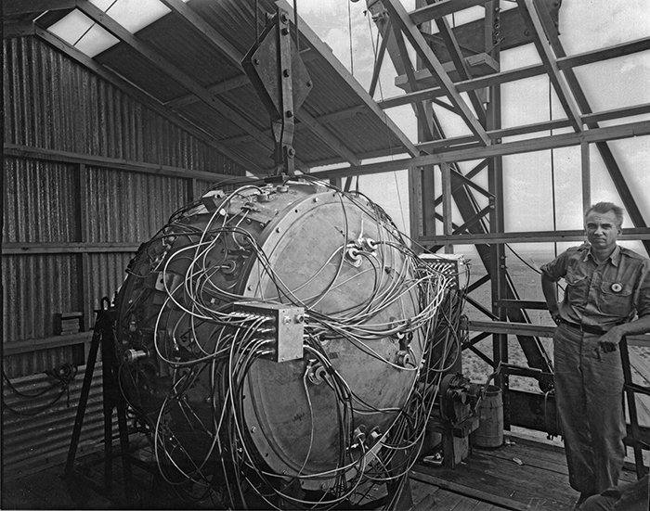
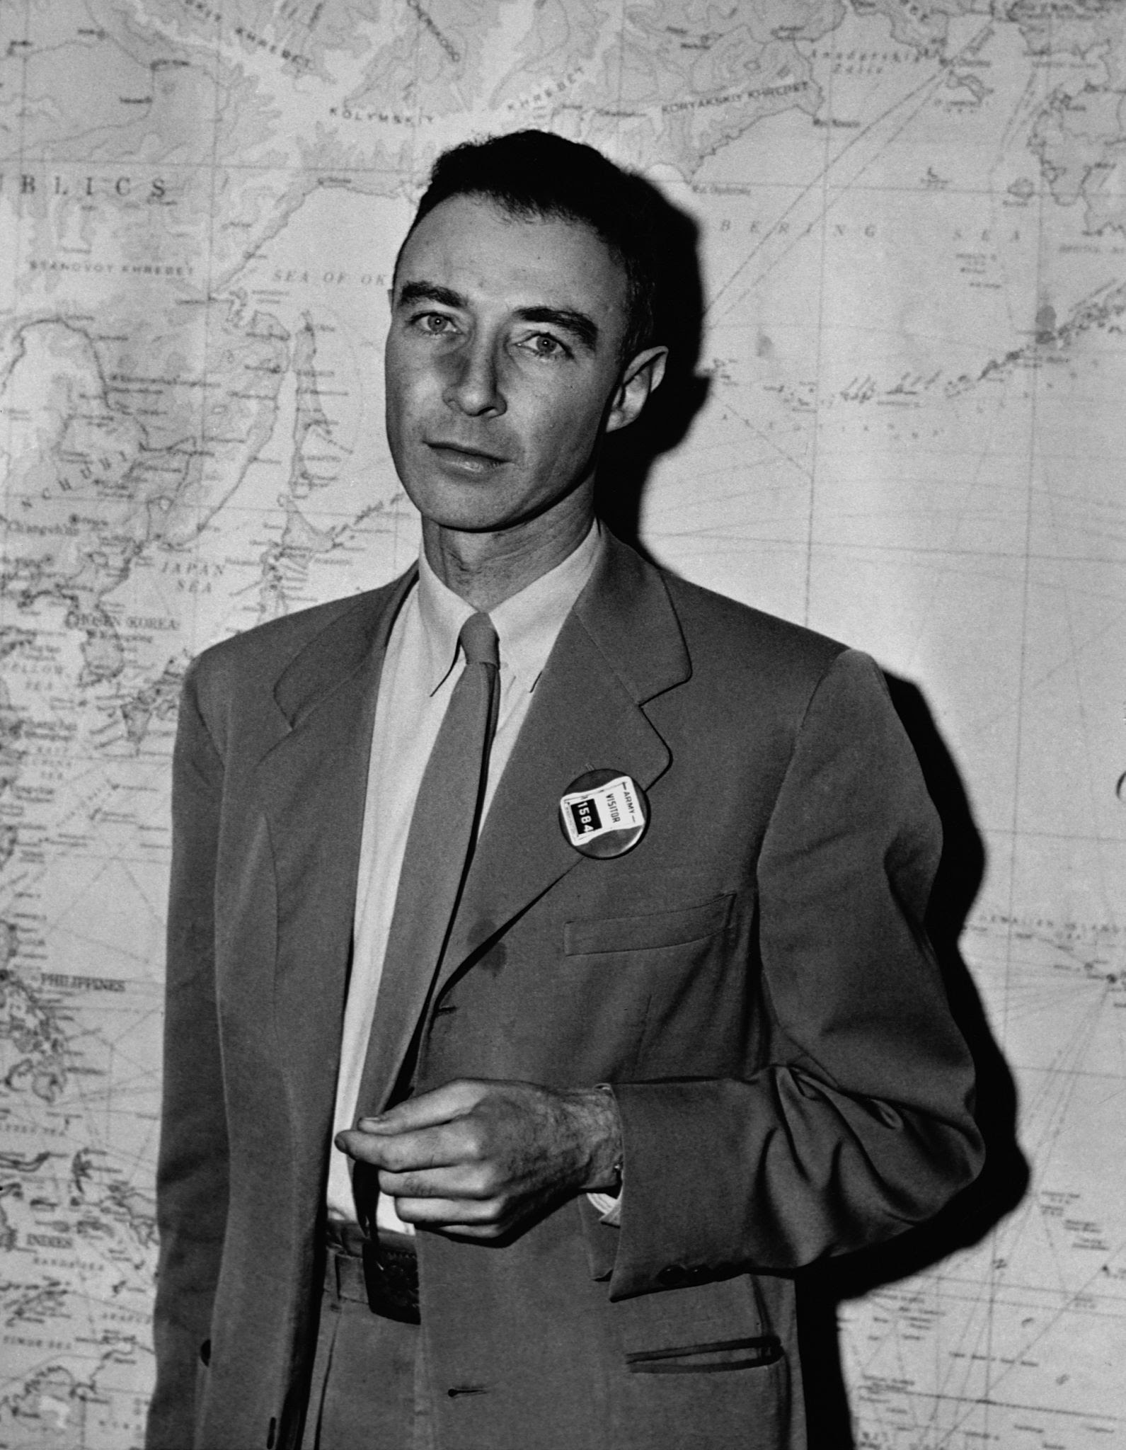
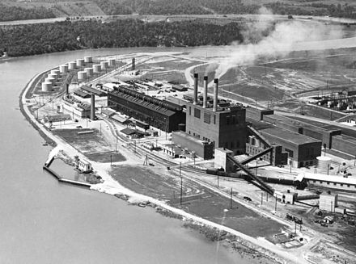
Historical context
Manhattan Project
Robert Oppenheimer
Earliest Inventions
Little boy
Fat man
This Photo by Unknown Author is licensed under CC BY-SA

Slide 5
Negative Impact on Humanity
Environmental Degradation
Health crisis
Nuclear enrichment
Global security

Slide 6

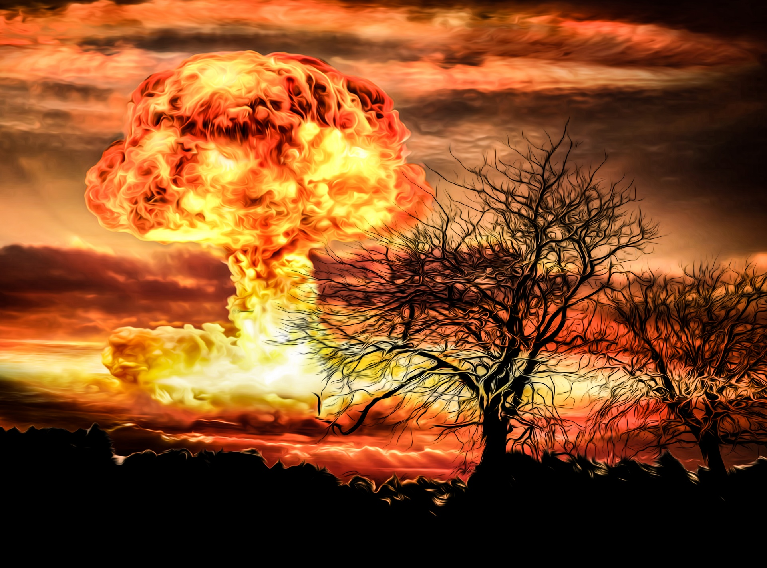
Health
Crisis

Slide 7
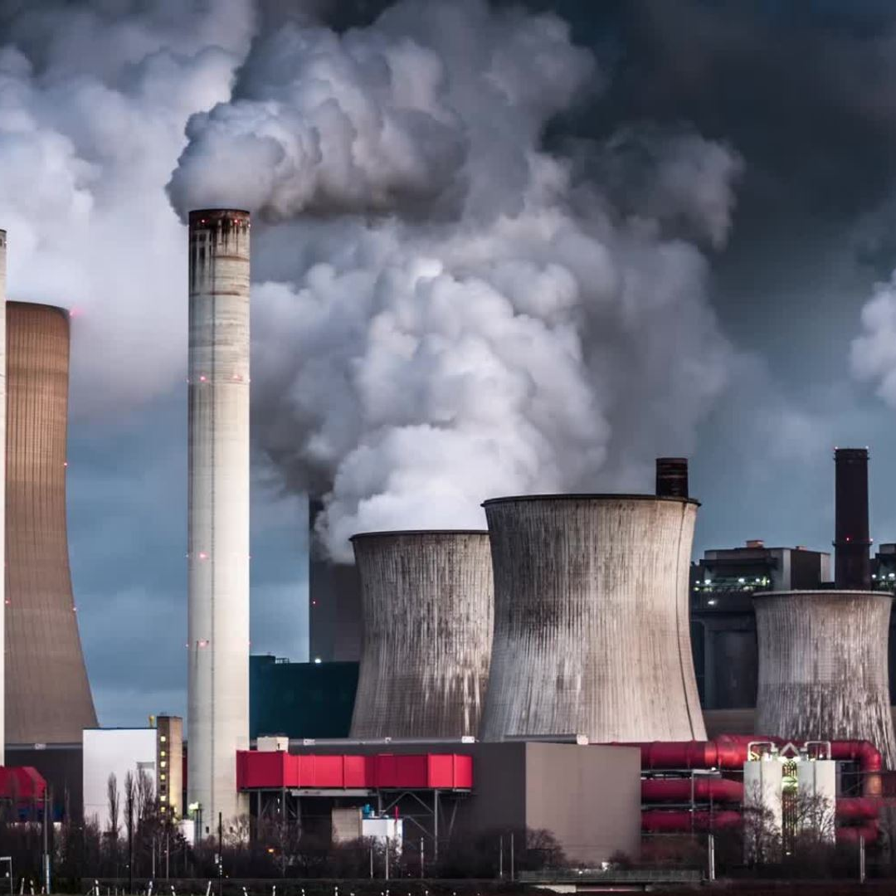
Geopolitical and Security Risks
Nuclear enrichment
Global security

Slide 8


Arguments For A Worldwide Ban
Environmental Protection
Economic Diversion

Slide 9

Conclusion
To sum up, we can make the world safer and better for everyone

Slide 10
Thank You

